Slide 1

Digigreen Hiring Challenge – 2025 Digigreen Recycling Pvt Ltd
Problem Statement proposal on
“Helping farmers detect crop diseases early and get actionable guidance using AI"
Title of problem Statement
"AgriTech for Sustainable Farming"
College name
Chennai Institute Of Technology
Team Name
Team AInstein
Team Members
Jonathan Christopher R – jonathanchristopherr.ece2024@citchennai.net (9840092807) [Team Lead]
Lokesh Karthikeyan- lokeshkarthikeyan.ece2024@citchennai.net (6381982531) [Member]
Mohanarajan M- mohanarajanm.ece2024@citchennai.net (9566225928) [Member]

Slide 2
Problem Context
Problem Statement:
Farmers in rural India face climate variability, scattered data, and low awareness of schemes, leading to poor decision-making and crop losses.
Limited connectivity and language barriers make existing digital tools inaccessible.
There is a need for a personalized, AI-driven assistant that delivers real-time, localized, and farmer-friendly guidance to enable sustainable agriculture.
Key Challenges Identified:
Data Overload and Fragmentation
Lack of Personalized Recommendations
Limited Access to Markets
Inefficient Use of Resources
Language and Literacy Barriers
Low Awareness of Government Schemes

Slide 3
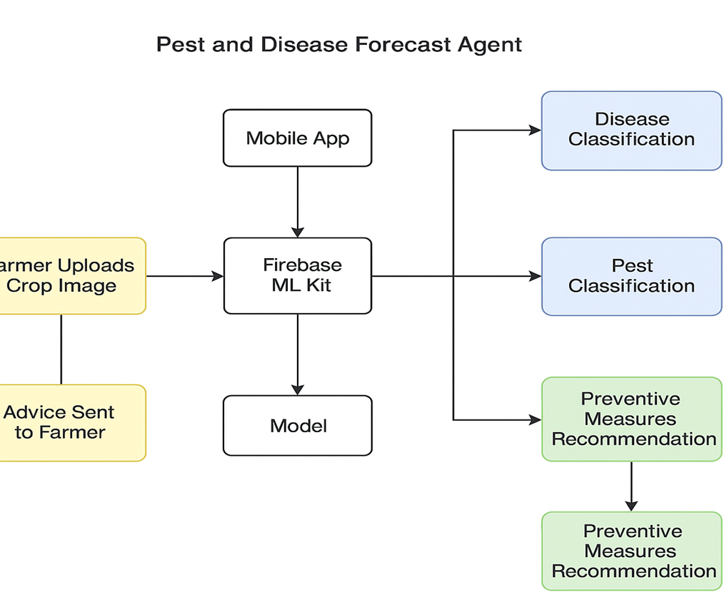
Proposed Solution
Data Collection – Crop disease images (PlantVillage, ICAR, farmer uploads) + supplementary data (weather, crop stage, location).
Model Training – Preprocess & augment images, balance dataset; train CNNs (ResNet, EfficientNet, MobileNet) or YOLOv8; optimize with TFLite/ONNX for mobile use.
Detection Pipeline – Farmers upload/capture images; AI runs offline/online; fallback to NLP-based symptom input if images unclear.
Advisory Generation – Provide tailored organic/chemical treatments, dosage, preventive measures; adjust advice by crop stage, weather, and farm size.
Communication Layer – Deliver advice via regional voice, text + images, SMS/alerts; push community notifications for nearby outbreaks.
Feedback Loop – Farmers rate recommendations; system retrains continuously for improved accuracy.
Block Diagram

Slide 4
Tech Stack

Slide 5
Impact:
Empowers farmers with real-time crop disease detection using simple image input and audio guidance.
Enhances agricultural productivity by enabling timely action against pests/diseases.
Reduces dependency on external experts, fostering self-reliance among farmers.
Promotes food security and contributes to sustainable farming practices.
Scalability:
Designed as a mobile-first solution, easily deployable across rural regions with smartphones.
Can scale to include multiple languages , widening accessibility.
Model can be extended to detect more crops, diseases, and soil health conditions.
Integration with IoT sensors, weather data, and market insights can expand its functionality for larger-scale use.
Potential for partnerships with government schemes, agri-cooperatives, and NGOs for mass adoption.
Final Thoughts:
AgroMind bridges the gap between cutting-edge AI technology and grassroots agricultural needs.
With a farmer-centric design, it aligns strongly with sustainability goals (SDGs 2, 9, and 12).
By combining simplicity, accessibility, and technological innovation, this solution can transform rural farming practices
The project is not just a tool for detection but a step toward digital agriculture transformation in India and beyond.

